Slide 1
Literature Review of Human Walking Kinematics with Deep Learning and Reinforcement Learning

Slide 2
‘Modelling Human Kinetics and Kinematics during Walking using Reinforcement Learning’ by Visak Kumar
-https://arxiv.org/pdf/2103.08125.pdf
- Develop an automated method to generate 3D human walking motion in simulation which is comparable to real-world human motion.
- Using Deep Reinforcement Learning to learn high-dimensional motor skills with robust variation in environment dynamics.
- Their approach iterates between policy learning and parameter identification to match the real-world bio-mechanical human data.
- Thorough evaluation of the kinematics, kinetics and ground reaction forces generated by our learned virtual human agent.

Slide 3
Method
Propose a framework to automate the process of developing bio-mechanically accurate 3D Human walking policies in simulation.
Human walking policy:
Represent a human policy as a multi-layered perceptron (MLP) neural network with two hidden layers of 128 neurons each.
A model-free reinforcement learning approach to develop a human locomotion policy. The action determines the target joint angles q(target) at t, of the proportional-derivative (PD) controllers, deviating from the joint angles in the reference motion.

Slide 4
2. Parameter Identification:
Once the policy is trained they can search over the parameter μ to identify the values which best explains reference motion data.
3. Error Threshold:
Iterate between policy optimization and parameter identification until the error, is less than a predefined threshold κ.
They combined error of joint angles generated by the policy and the ground truth joint angles, the joint moments and the groundtruth joint moments, the ground reaction forces and ground reaction forces measured in the real-world.

Slide 5
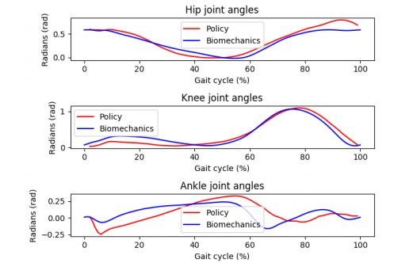
Results
The lower-limb joint angles before and after the CMA-ES (Covariance Matrix Adaptation Evolution Strategy) optimization step.
Joint angles after RL step

Slide 6
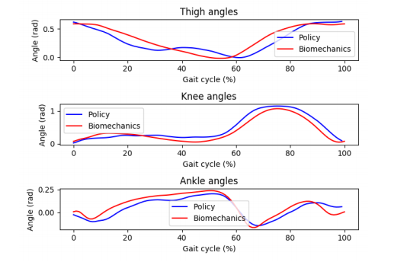
After CMA-ES (Covariance Matrix Adaptation Evolution Strategy) optimization step, the joint angles match better with real-world data.

Slide 7
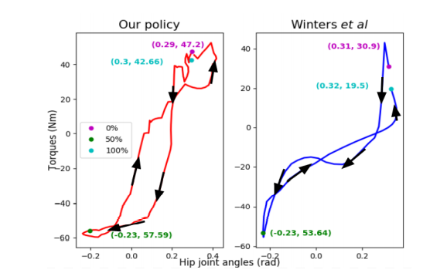
Comparison of torque loops of a typical trajectory generated by our policy and human data at the hip of stance leg during a gait cycle. The green dots indicate the start and the black dots indicate 50% of the gait cycle. The arrows show the progression of the gait from 0% to 100%.

Slide 8
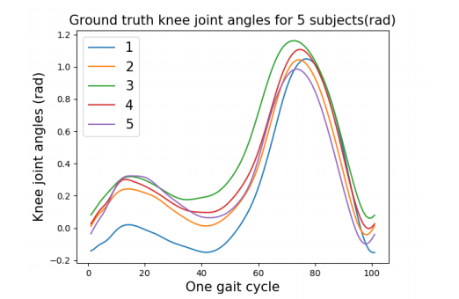

Slide 9
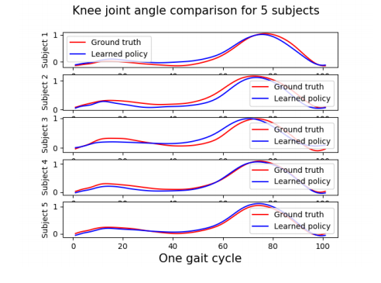

Slide 10
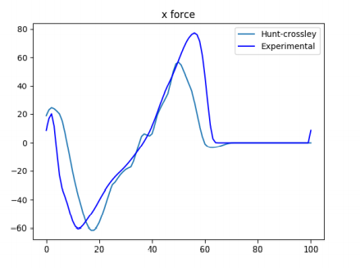
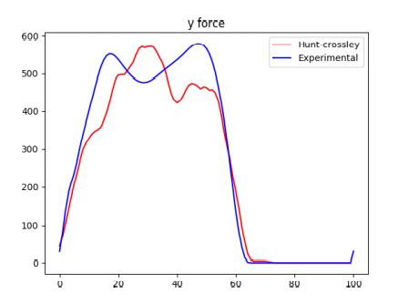
Tangential ground reaction force and Vertical ground reaction force.

Slide 11
Future direction
How well can we model a walking gait generated by a person with disability?
Learn interesting assistive strategies for an exoskeleton such as assistive walking to reduce metabolic cost of walking or to assist recovery when there is an external perturbation such a strips or slips?

Slide 12
2. ‘DeepMimic: Example Guided Deep Reinforcement Learning of physics based character skills’ by XUE BIN PENG, PIETER ABBEEL, SERGEY LEVINE, MICHIEL VAN DE PANNE
https://arxiv.org/abs/1804.02717
Character animation is to combine data-driven specification of behavior with a system that can execute a similar behavior in a physical simulation, thus enabling realistic responses to perturbations and environmental variation.
Their method handles keyframed motions, highly-dynamic actions such as motion-captured flips and spins, and retargeted motions. By combining a motion-imitation objective with a task objective, they can train characters that react intelligently in interactive settings.

Slide 13
Overview
System receives as input a character model, a corresponding set of kinematic reference motions, and a task defined by a reward function.
Each reference motion is represented as a sequence of target poses.
A control policy maps the state of the character, a task-specific goal to an action at, which is then used to compute torques to be applied to each of the character’s joints.
Each action specifies target angles for proportional-derivative (PD) controllers that then produce the final torques applied at the joints.
The reference motions are used to define an imitation reward and the goal defines a task-specific reward.

Slide 14
The final result of our system is a policy that enables a simulated character to imitate the behaviours from the reference motions while also fulfilling the specified task objectives.
The policies are modeled using neural networks and trained using the proximal policy optimization algorithm.
Their approach is to understand the learned control strategies and compare them to the equivalent human strategies.

Slide 15
3. Learning Dexterity
https://openai.com/blog/learning-dexterity/
System, called Dactyl, is trained entirely in simulation and transfers its knowledge to reality, adapting to real-world physics.
Dactyl learns from scratch using the same general-purpose reinforcement learning algorithm and code as OpenAI Five.

Slide 16
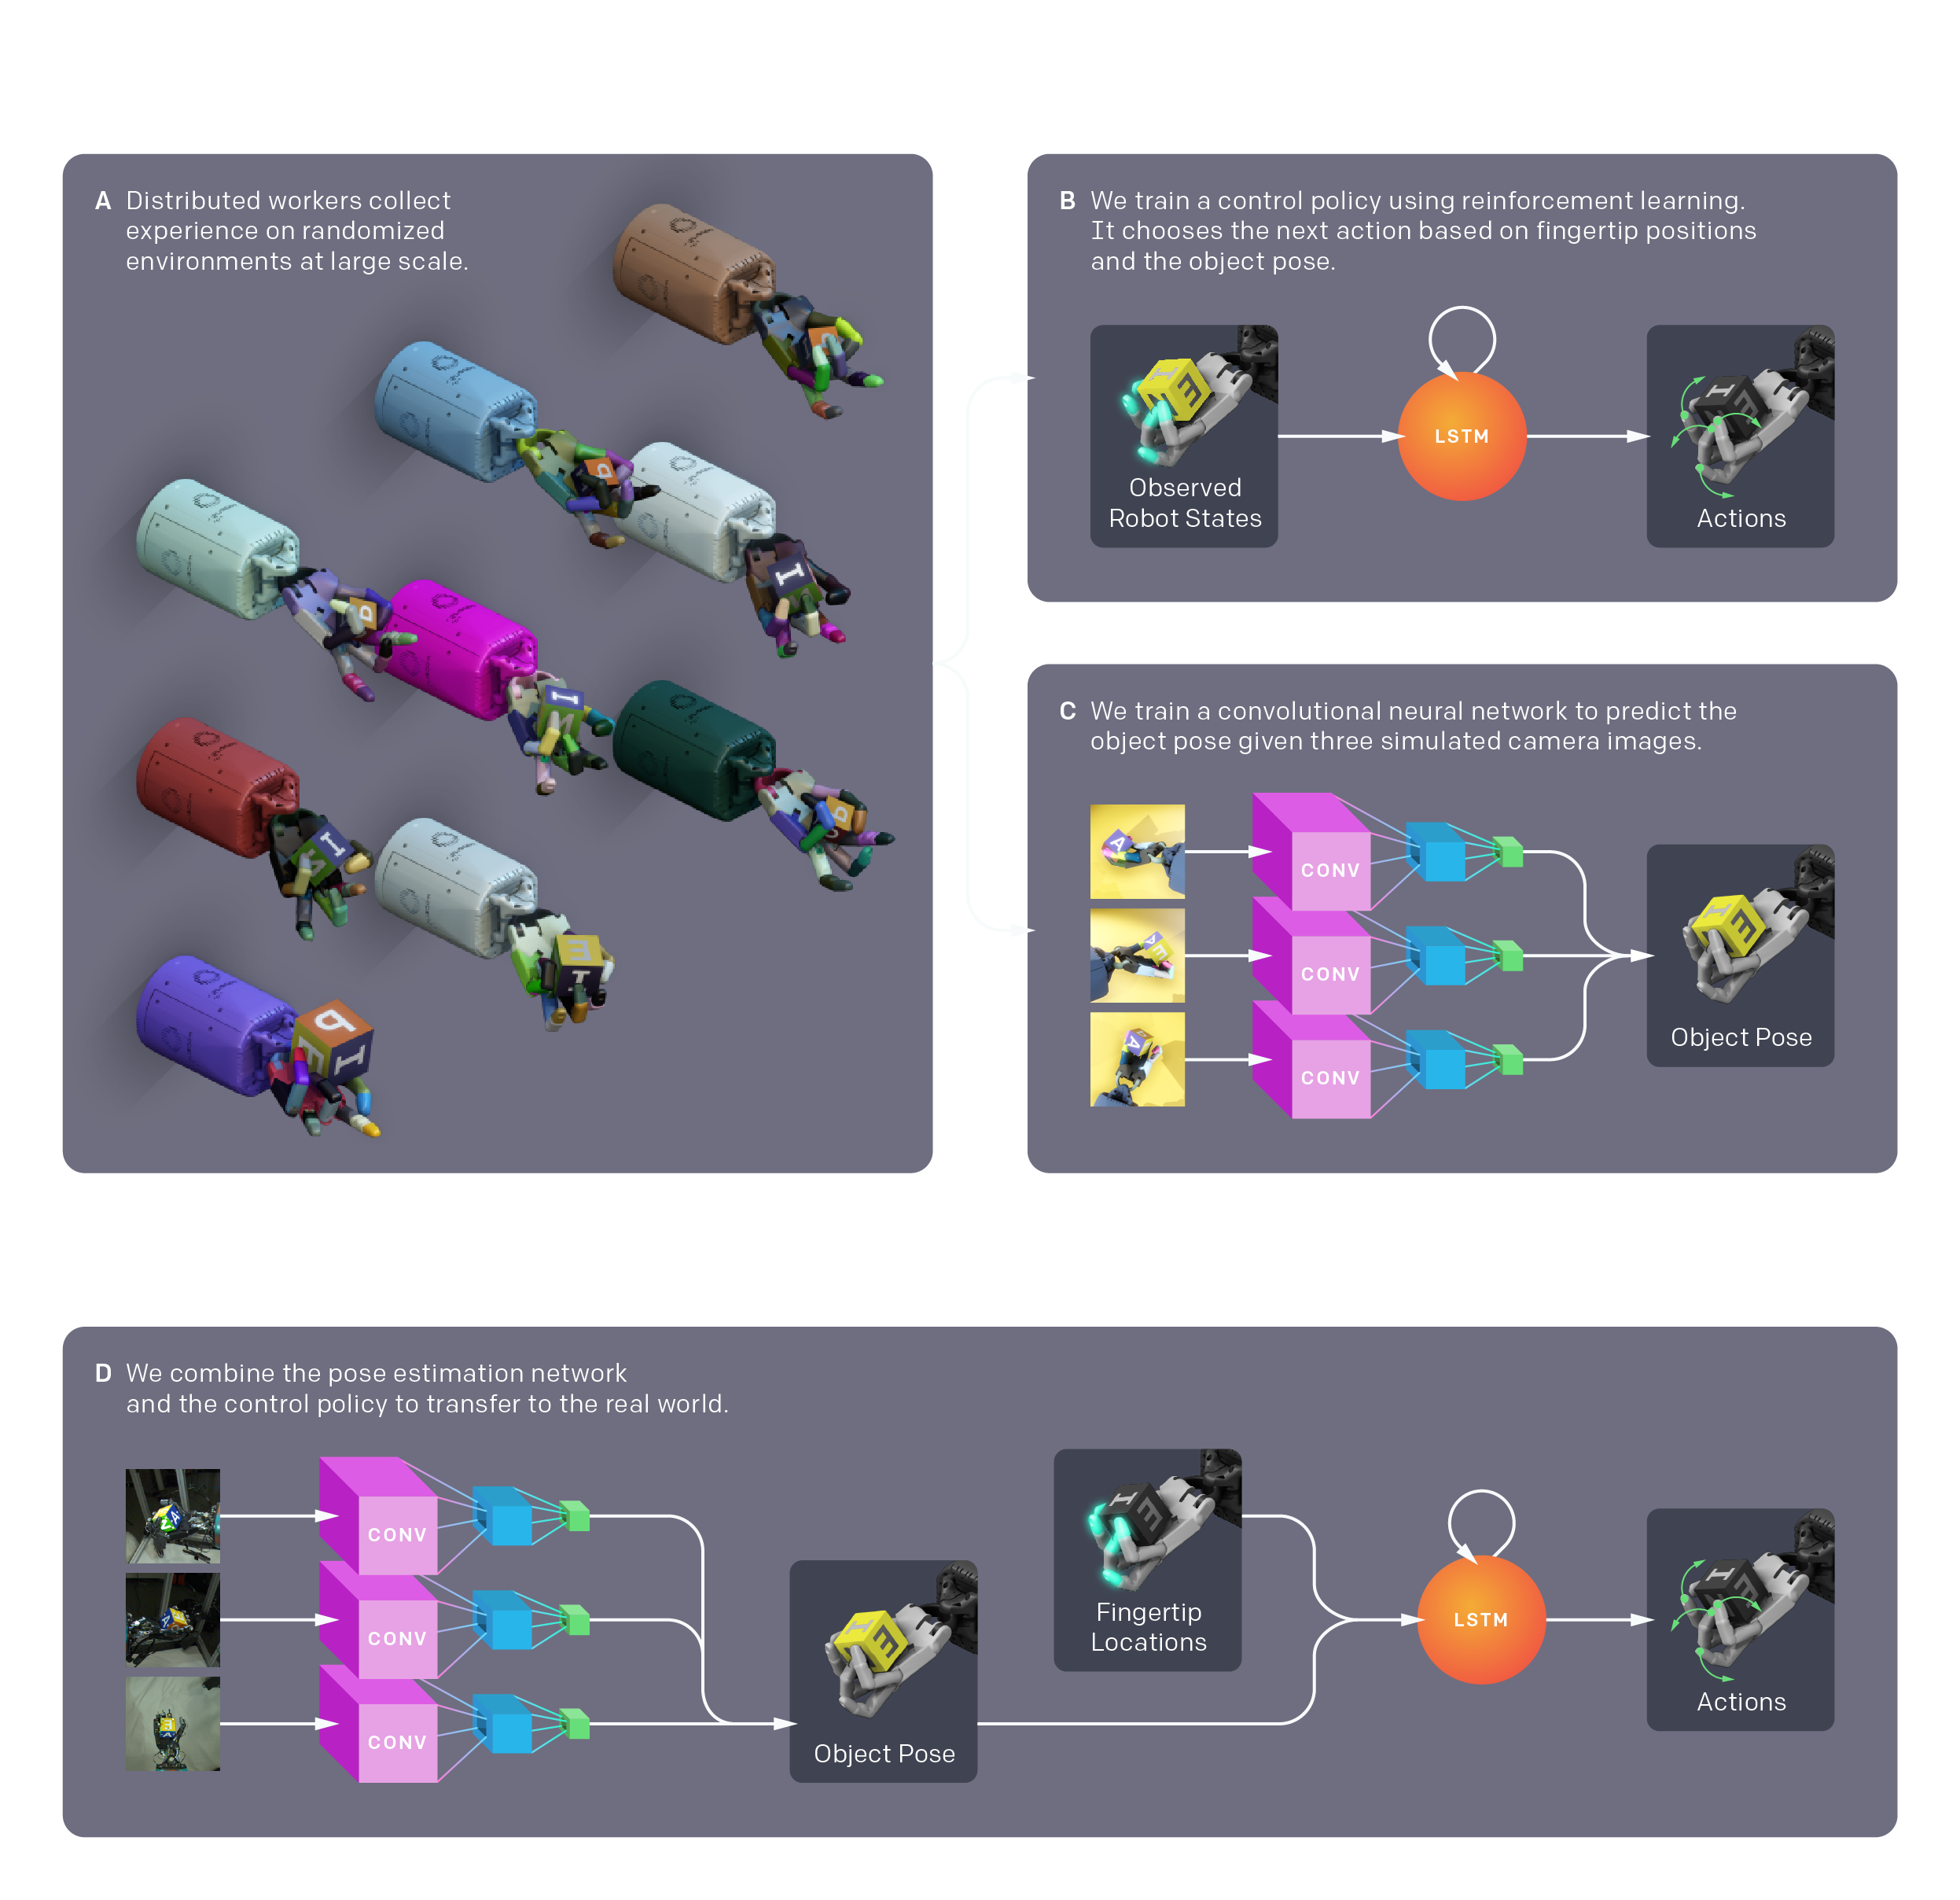

Slide 17
4. Solving Rubik’s Cube with Robotic Hand
https://openai.com/blog/solving-rubiks-cube/
The neural networks are trained entirely in simulation, using the same reinforcement learning code as OpenAI Five paired with a new technique called Automatic Domain Randomization (ADR).
They train neural networks to solve the Rubik’s Cube in simulation using reinforcement learning and Kociemba’s algorithm for picking the solution steps.
Domain randomization enables networks trained solely in simulation to transfer to a real robot.
ADR exposes the network to an endless variety of randomized simulations. It is this exposure to complexity during training that prepares the network to transfer from simulation to the real world.

Slide 18
5. ‘Deep reinforcement learning for modeling human locomotion control in neuromechanical simulation’ by Seungmoon Song, Lukasz Kidzinski, Xue Bin Peng, Carmichael Ong, Jennifer Hicks, Sergey
Levine, Christopher G. Atkeson, and Scott L. Delp
https://doi.org/10.1101/2020.08.11.246801
Researchers have developed control models that encode physiologically plausible motor control hypotheses and compared the resulting simulation behaviors to measurable human motion data. While such plausible control models were able to simulate and explain many basic locomotion behaviors.
In this paper, they review the current state of neuromechanical simulations, along with the fundamentals of reinforcement learning, as it applies to human locomotion.
They also present a scientific competition (“Learn to Move" organizing at the NeurIPS conference) and accompanying software platform (OpenSim-RL environment), which they have organized to accelerate the use of reinforcement learning in neuromechanical simulations.

Slide 19
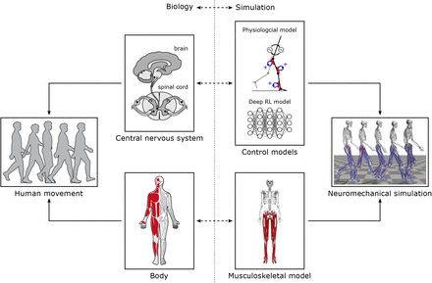
Neuromechanical
simulation

